Slide 1
WELCOME TO THE REALTOR® PARTY OF CALIFORNIA (RPC)
YOUR VOICE FOR ADVOCACY

Slide 2
YOUR VOICE FOR ADVOCACY
https://vimeo.com/1051636904/0f6f8ddcde?share=copy

Slide 3
The REALTOR® PARTY AND REALTOR® ACTION FUND WORK TOGETHER :
Q1: What is the REALTOR® Action Fund (RAF)?
A1: RAF is the money raised to advance the goals of the RPC & protects homeownership.

Slide 4
The REALTOR® PARTY AND REALTOR® ACTION FUND WORK TOGETHER :
Q2: Why investing is so important?
A2: YOUR VOICE FOR ADVOCACY!

Slide 5
The REALTOR® PARTY AND REALTOR® ACTION FUND WORK TOGETHER :
Q3: What is the REALTOR® PARTY OF CALIFORNIA (RPC)?
A3: The REALTOR® PARTY OF CALIFORNIA advances the values that protect homeownership!

Slide 6


The REALTOR® PARTY OF CA is about…
Community Outreach
Issue Engagement
Notes:
Insert legislative slide

Slide 7
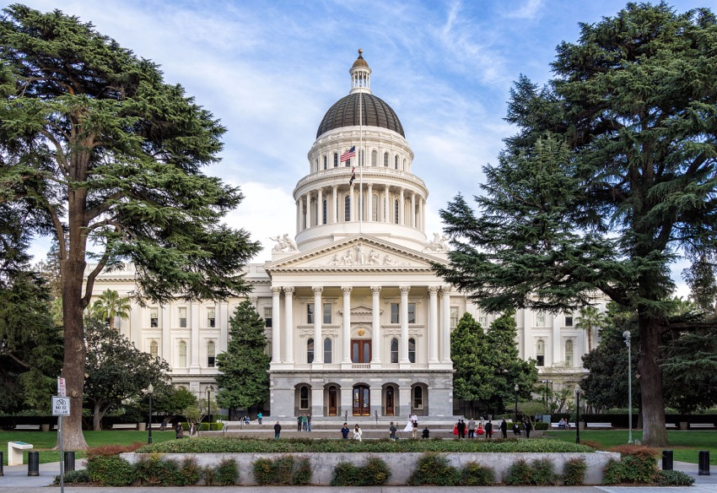
The REALTOR® PARTY of CA At Work:
Advances Home ownership
Protects homeownership
Builds stronger communities
Safeguards your business

Slide 8

Legislative Successes
AB 2992 (Nguyen) – SIGNED
Mandates buyer-broker representation agreements for all Real Estate licensees in California.
SB 684 (Caballero) – SIGNED
Streamlines the approval process for development projects of single-family subdivisions.
SB 1103 (Menjivar) – SIGNED
Requires notice of specified rent increases to leases of commercial real property.
AB 2493 (Pellerin) – SIGNED
Regulates the circumstances in which landlords can charge an application screening fee.

Slide 9

The REALTOR® Party of CA at work:
Preserves Mortgage Interest Deduction
Prevent Statewide Service Tax
Protects Independent contractor status
Fights Rent Control

Slide 10

Legislative Successes
SB 1462 (Glazer) – STOPPED
Developers from using buyers deposit out of escrow to use for construction costs.
AB 1932 (Ward) – STOPPED
A bill to remove the mortgage interest deduction on second homes.
AB 2187 (Bryan) – STOPPED
A bill that would have established the Office of Tenants Rights and Protections to host and maintain information already available elsewhere.
AB 2539 (Connolly) – STOPPED
A bill that would have restricted mobile-home park owners from selling their park until they first collected offers from resident organizations.

Slide 11

Prop 33 – C.A.R. OPPOSED - FAILED
This strongly-opposed proposition was defeated in every single county in California!
 | Yes | 5,640,719 | 39.7%
 | No | 8,570,352 | 60.3%

Slide 12
What Can YOU Do?
Vote
Invest
Act

Slide 13

Vote!
Register to Vote: registertovote.ca.gov
Go to the Polls – at every election

Slide 14



ACT!
Get involved in our REALTOR® Association
Respond to:
N.A.R.’s
C.A.R.’s
Notes:
Create more human approach to this act…

Slide 15
HAVE INFLUENCE
Invest in REALTOR® Action Fund
$25
Introductory Level
$49
Participation Club
$148
Cost of Doing Business
$449
Capitol Club

Slide 16

HAVE INFLUENCE
Invest in REALTOR® Action Fund

Slide 17
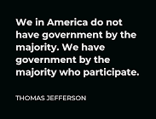
REALTOR® Party of California:
Citizen’s Responsibility

Slide 18

YOU ARE THE
It is not a Red problem, it is not a Blue problem, it is a #Purple Solution!
Notes:
You are the REALTOR® Party.
We need you to be involved. Vote, Act, Invest to make the REALTOR® Party strong and effective. You can make a difference in our community and in our country.

